Slide 1
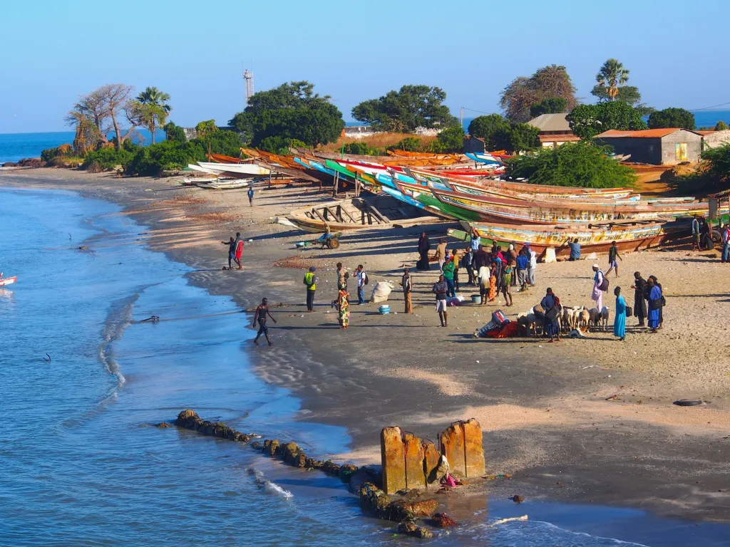

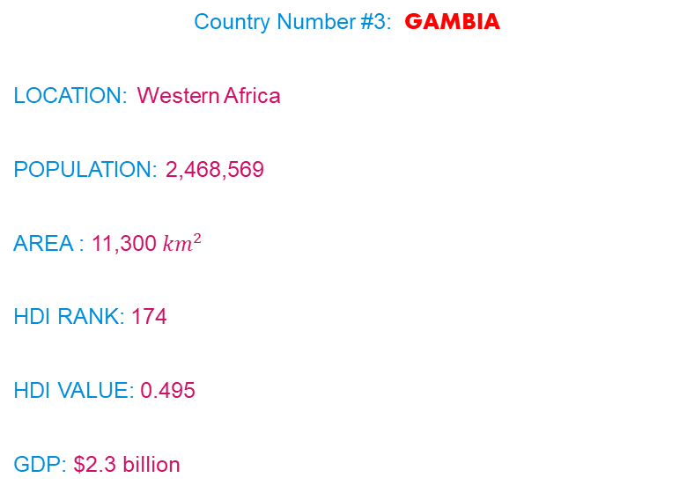

DEVELOPMENT OF WORLD ECONOMY
COUNTRY
The first two country which I selected was Singapore which was at Very high HDI, and Granada High HDI.
Country Number #3: GAMBIA
LOCATION: Western Africa
POPULATION: 2,468,569
AREA : 11,300 ${km}^{2}$
HDI RANK: 174
HDI VALUE: 0.495
GDP: $2.3 billion
VISHNU SHARMA NANDA
STUDENT NO. : 231AJG024

Slide 2

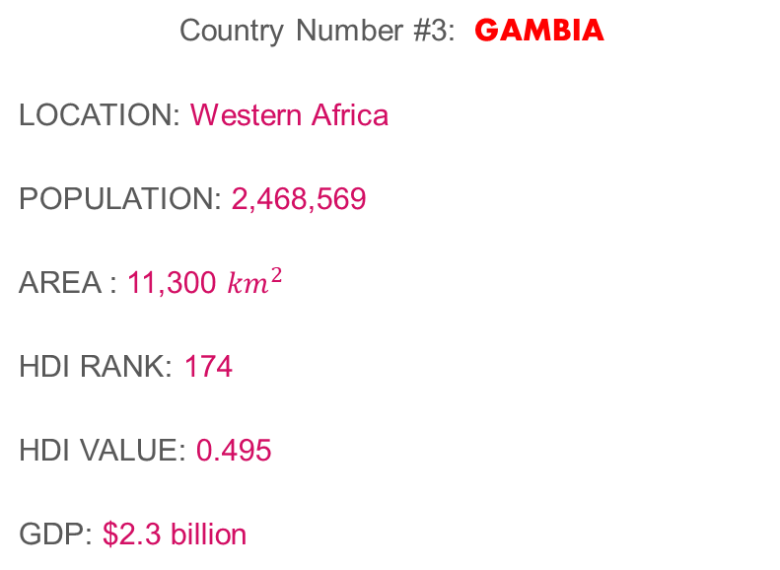
COUNTRY
country No1 by HDI, by element of UN HDI
long and healthy life | 62.9 years
Education | 9 years
Income | $2090
The first two country which I selected was Singapore which was at Very high HDI, and Grenada High HDI.
Country Number #3: GAMBIA
LOCATION: Western Africa
POPULATION: 2,468,569
AREA : 11,300 ${km}^{2}$
HDI RANK: 174
HDI VALUE: 0.495
GDP: $2.3 billion

Slide 3
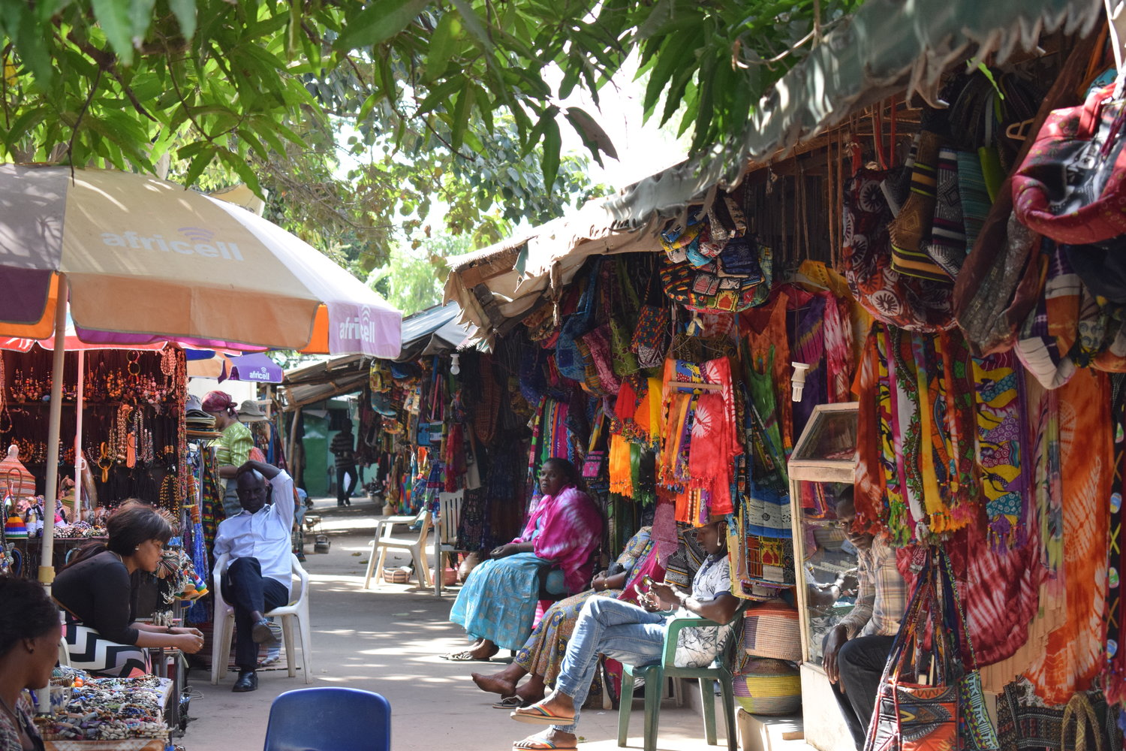
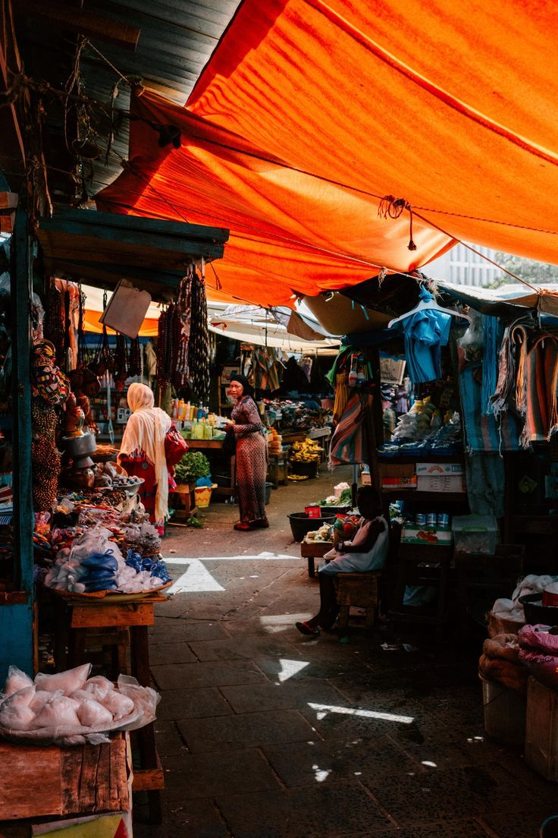
Why is Gambia so poor?
country No1 by HDI, by element of UN HDI
long and healthy life | 62.9 years
Education | 9 years
Income | $2090
Gambia faces poverty due to various factors, including limited economic diversification, reliance on agriculture with vulnerability to climate change, political instability, weak infrastructure, and high levels of unemployment.
Additionally, issues such as corruption, inadequate access to education and healthcare, and limited access to markets contribute to its economic challenges. These factors hinder sustainable development and exacerbate poverty levels, making it difficult for the country to break the cycle of poverty and achieve significant economic growth.

Slide 4
Why is Gambia so poor?
Limited Resources:
The Gambia has limited natural resources, with agriculture being the primary economic activity. Dependence on agriculture makes the economy vulnerable to factors like climate change and fluctuating commodity prices
Historical Factors:
Colonialism and its aftermath have left a legacy of economic inequality and underdevelopment. The country's history includes periods of political instability and authoritarian rule, hindering long-term development efforts.
Population Pressures:
The population growth rate in The Gambia is relatively high, putting pressure on limited resources and infrastructure, exacerbating poverty and unemployment.

Slide 5
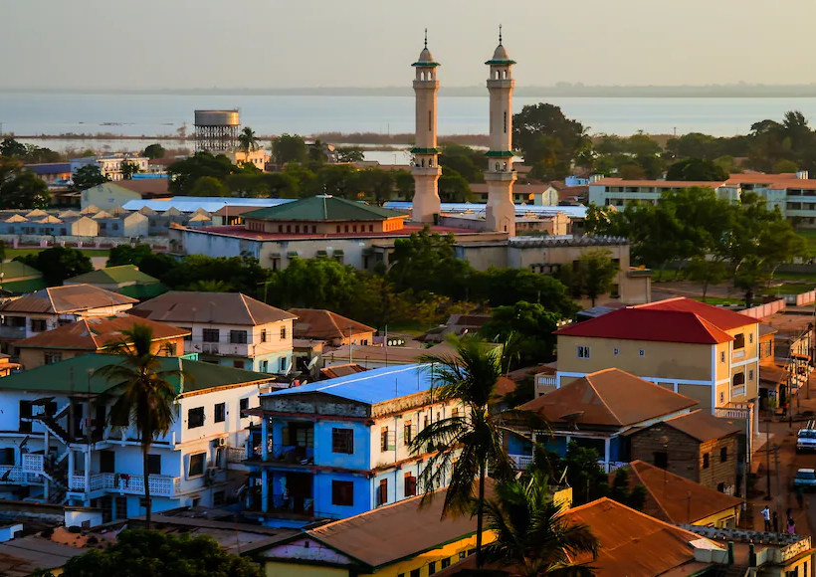
Why is Gambia so poor?
Education and Healthcare:
While efforts have been made to improve education and healthcare, access to quality services remains limited, affecting human capital development and productivity.
Technological Advancement:
The Gambia lags behind in technological advancements compared to more developed nations, limiting its ability to innovate and compete in global markets.
Institutional Challenges:
Corruption, weak governance, and inadequate infrastructure hinder private sector development and foreign investment, impeding economic growth and poverty reduction efforts.

Slide 6
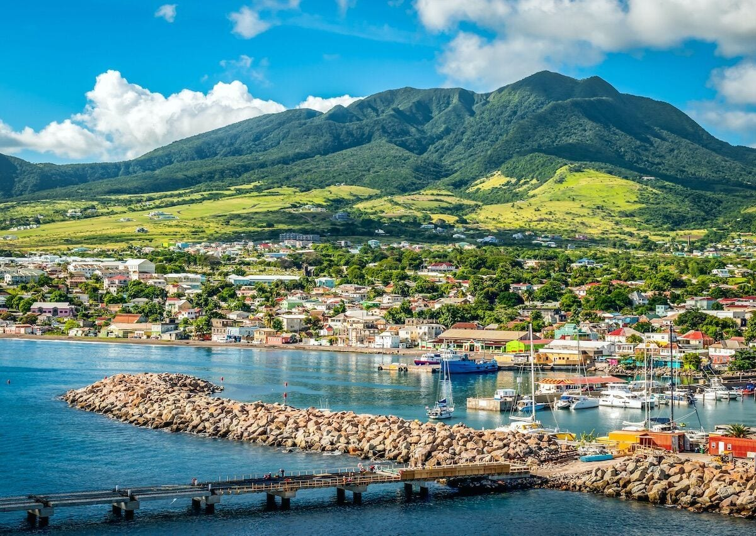
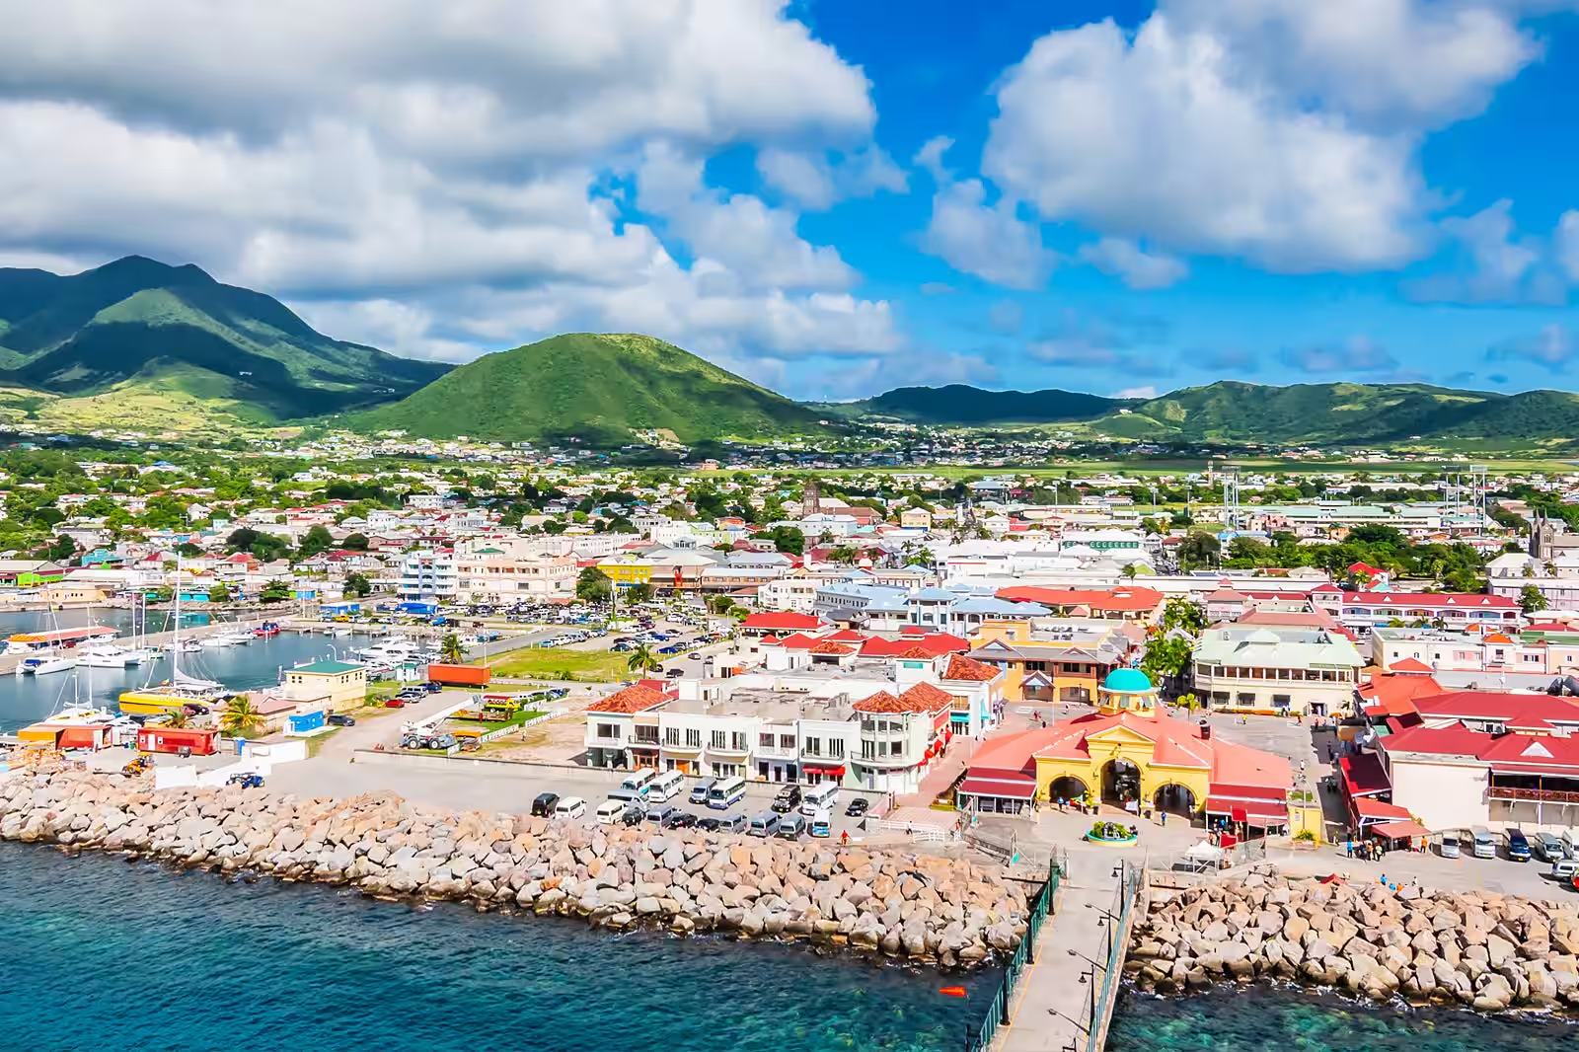
Is their a potential for Gambia to become a high HDI such as Granada
Achieving a high Human Development Index (HDI) similar to Granada may be challenging for The Gambia due to significant socio-economic hurdles. However, there is potential for The Gambia to elevate its HDI to a medium level with focused efforts.
The Gambia faces obstacles such as poverty, limited access to education and healthcare, political instability, and weak infrastructure. To improve its HDI, The Gambia needs to prioritize initiatives like enhancing education and healthcare access, fostering economic diversification, and addressing governance issues. While reaching a high HDI may be ambitious in the short term, focusing on incremental improvements and building a foundation for sustainable development can pave the way for The Gambia to enhance the well-being of its population over time.

Slide 7
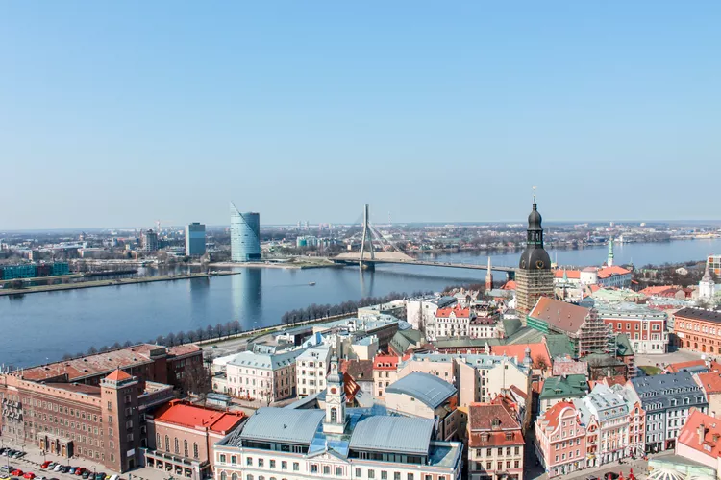
HOW LATVIA HAS ESCAPED THE FATE OF GAMBIA.
Geographic Location and Access to Markets: Latvia's location in Europe, as part of the European Union, provides access to larger markets, trade opportunities, and investment flows. This has facilitated economic growth and development, contributing to higher HDI indicators.
Investments in Education and Healthcare:
Latvia has prioritized investments in education and healthcare, ensuring access to quality services and human capital development. This has contributed to higher levels of education, healthcare outcomes, and overall well-being, reflected in Latvia's higher HDI.
International Integration and Cooperation: Latvia's integration into global and regional networks, including the European Union and NATO, has facilitated collaboration, exchange of ideas, and access to resources and expertise, supporting its development trajectory and HDI improvement.
Investments in Education and Healthcare: Latvia has prioritized investments in education and healthcare, ensuring access to quality services and human capital development. This has contributed to higher levels of education, healthcare outcomes, and overall well-being, reflected in Latvia's higher HDI.

Slide 8
CONCLUSION
In my opinion, The Gambia's challenges are multi-faceted and interconnected, requiring comprehensive strategies addressing governance, education, healthcare, infrastructure, and economic diversification to break the cycle of poverty and achieve sustainable development. However, overcoming these challenges requires significant political will, international cooperation, and targeted investments in key sectors to improve the country's Human Development Index (HDI) and lift its population out of poverty.

Slide 9
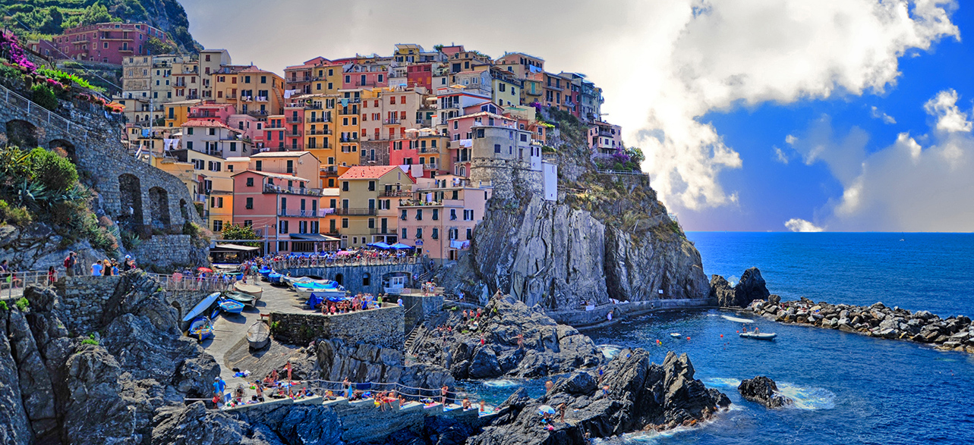
THANK YOU

